Slide 1
AnalyZing Amazon Sales
Samuel Nadar

Slide 2
Introduction

Slide 3
Sales management has gained importance to meet increasing competition and the need for improved methods of distribution to reduce cost and to increase profits.
Sales management today is the most important function in a commercial and business enterprise.
NOTE : Ship Date is considered as Sales Date

Slide 4
Relation
Unit Price * Units Sold == Total Revenue
Unit Cost * Units Sold == Total Cost
Total Revenue - Total Cost == Total Profit

Slide 5

Evaluation Metric
Formula:
Profitability Ratio $= \frac{Total Profit}{Sales}$

Slide 6
Technology Stack

Slide 7






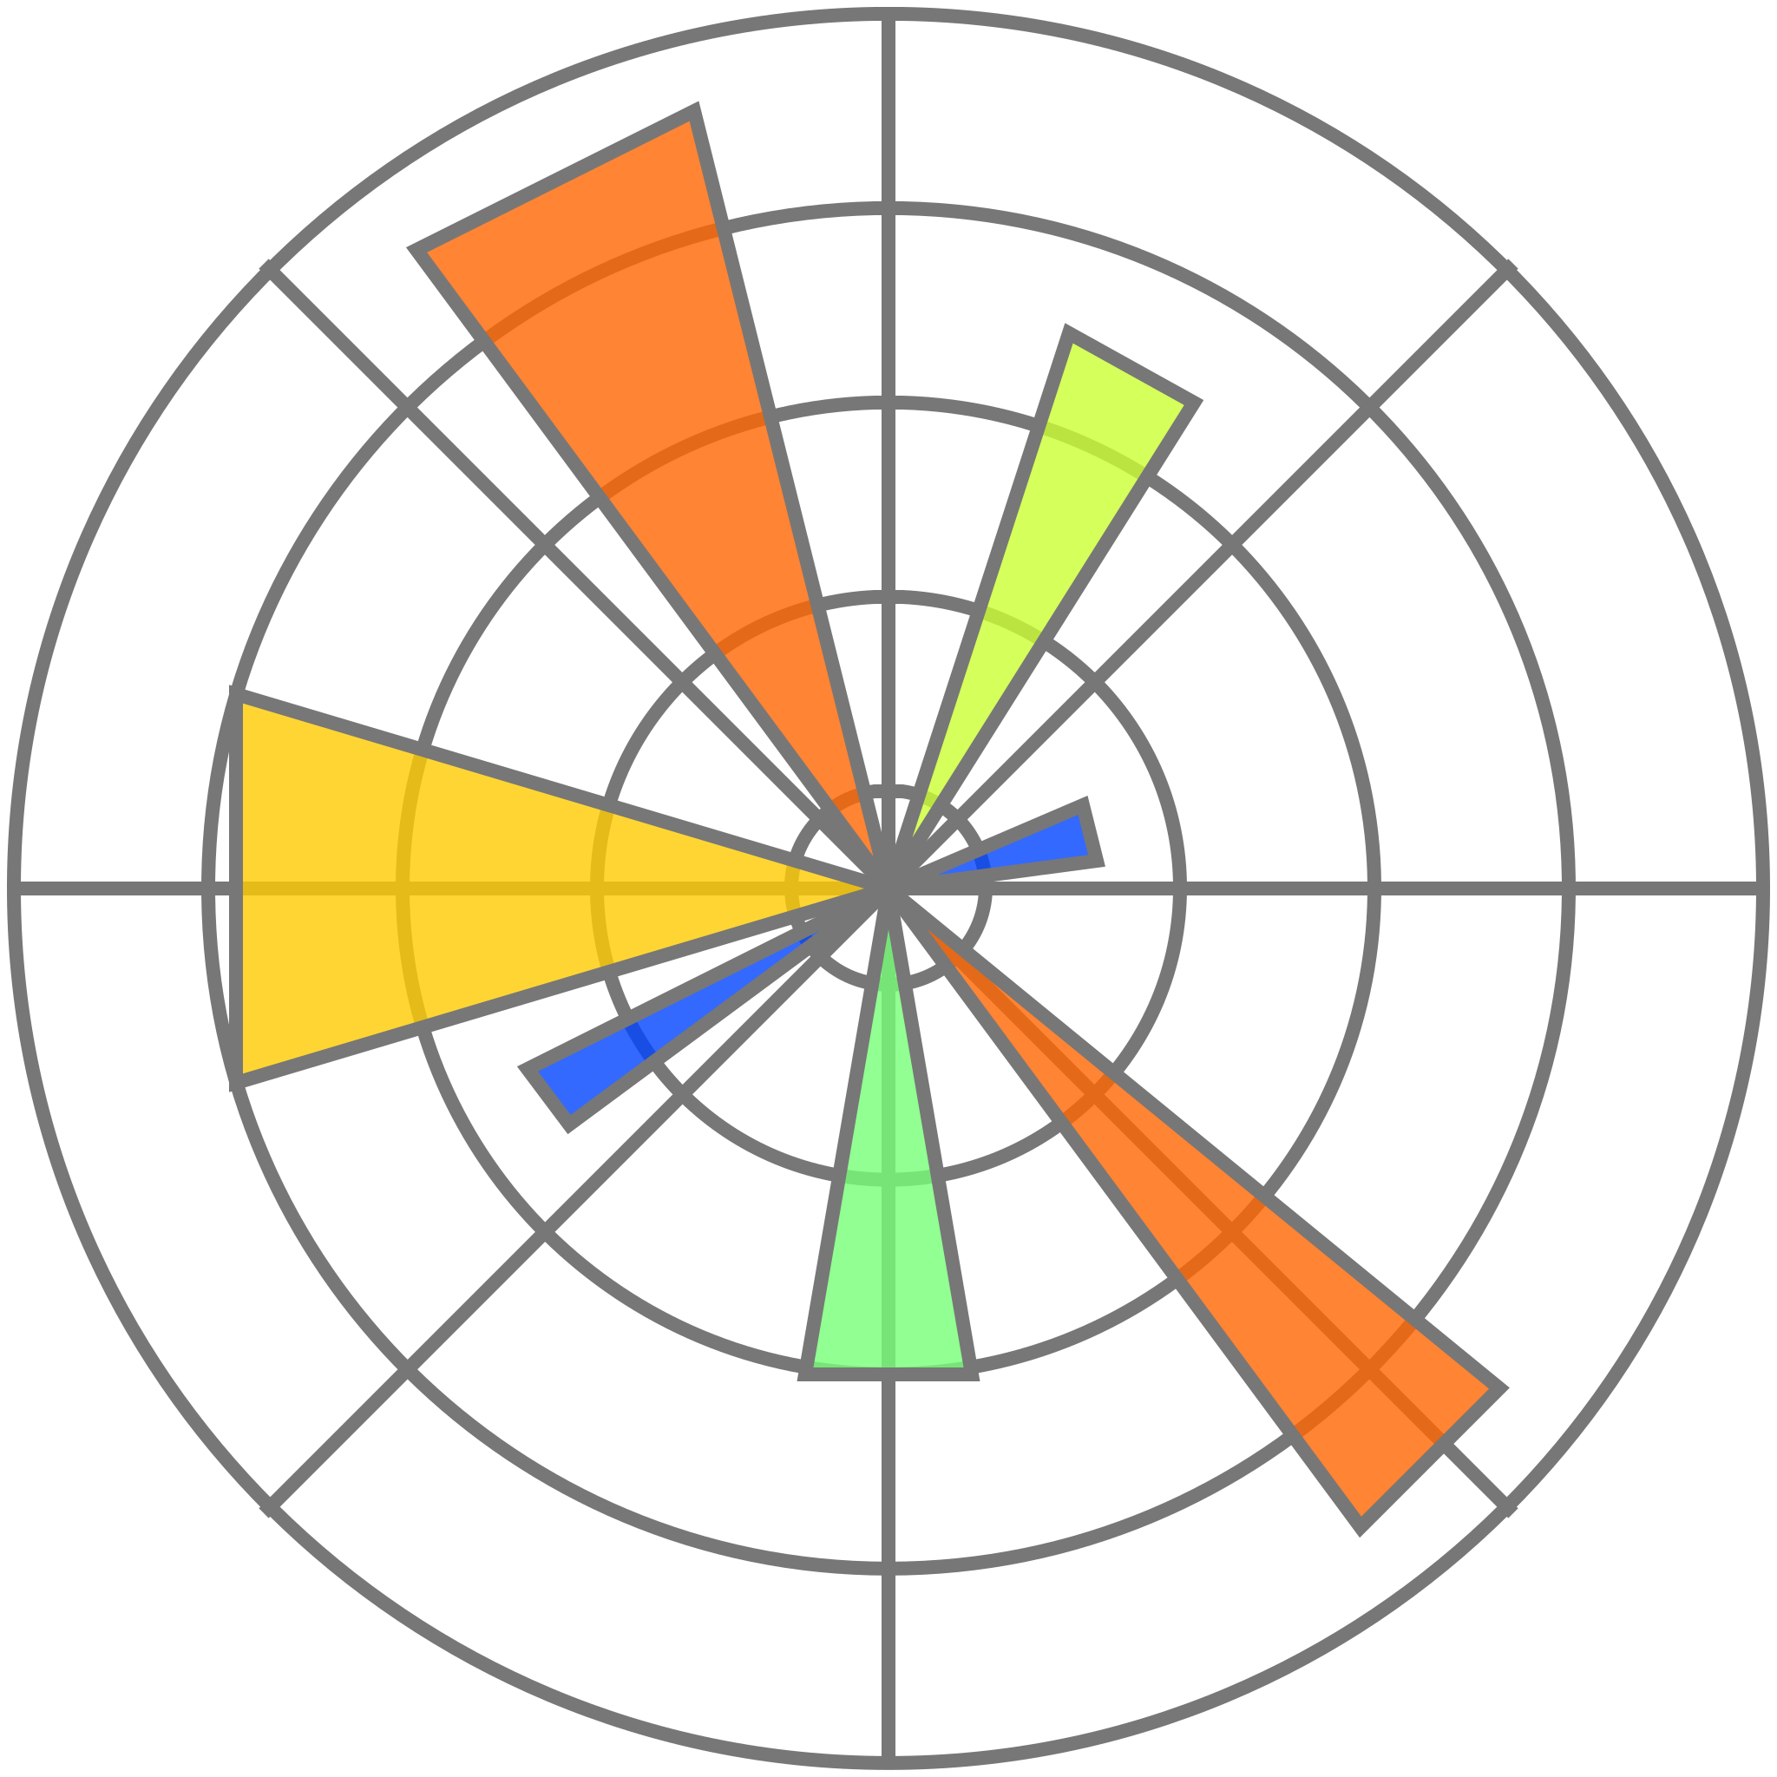







Slide 8
Steps in Data Analytics

Slide 9
Data Preprocessing (ETL)
Exploratory Data Analysis (EDA)
Machine Learning Algorithms
Dashboard

Slide 10
Exploratory Data Analysis (EDA)

Slide 11
Offline sales channel (53.97%) dominates online sales channel with more profitability ratio
Profitability Ratio - High > Medium > Low > Critical
Most of the Units Order are of High Priority or Low Priority
Profitability Ratio is higher in Middle East and North Africa > Europe > Asia
Sales is mostly in Sub-Saharan African Region
Asian Products are costly
Cosmetics generate high profitability ratio and dominate the sales
Household and Office supplies are costly products
Sub-Saharan African region orders all item types

Slide 12
CONTD.
Australia and Oceania, Middle East and North Africa, and Europe mainly uses online channel
Central America and the Caribbean, and Sub-Saharan Africa mainly uses offline channel
Beverages have critical priority
Cereal, Cosmetics and Vegetables have high priority
Office Supplies have medium priority
Fruits, Household and Personal Care have low priority
Beverages, Household and Personal Care are sold mainly through offline channel
Fruits are sold mainly through online channel
High Priority Orders are mainly sold through offline channels whereas low priority orders are mainly sold through online mode

Slide 13
Linear Regression
Unit Price = 1.2358 * Unit Cost + 40.6587

Slide 14
Machine Learning

Slide 15
Types of Machine Learning
Supervised Learning
Regression
Unsupervised Learning
Association Rule Learning using Apriori and FP Growth

Slide 16
Fundamental Steps in ML
Data Preprocessing
ML Algorithm Selection
Fitting the Model
Model Evaluation
R-Scored, Mean Square Error, Mean Absolute Error

Slide 17
Performance of MODEL
XGBoost Regressor > Random Forest Regressor > LightGBM Regressor > Linear Regression > Support Vector Regressor > Decision Tree Regressor > Neural Network (due to less dataset)

Slide 18
Association Rule Mining

Slide 19
Maximal Frequent Itemsets
{'Beverages', 'Clothes', 'Cosmetics’}
{'Cereal', 'Clothes', 'Cosmetics’}
{'Office Supplies', 'Clothes', 'Fruits', 'Cosmetics’}
{'Clothes', 'Personal Care', 'Household', 'Cosmetics'}

Slide 20
Association Rules
(Clothes, Personal Care) -> (Cosmetics, Household)
(Clothes, Household) -> (Personal Care, Cosmetics)
(Personal Care, Cosmetics) -> (Clothes, Household)
(Cosmetics, Household) -> (Clothes, Personal Care)
Support - 0.571429
Confidence – 1.0
Lift – 1.75
Leverage - 0.244898

Slide 21
Dashboard

Slide 22
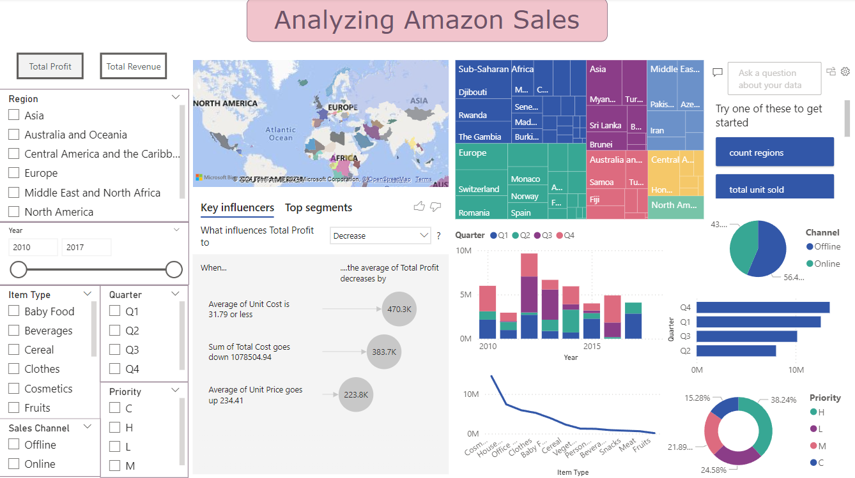

Slide 23
Thank You

